Slide 1

CS 533 INTRO TO DATA SCIENCE
Michael Ekstrand

Slide 2
PREDICTION AND OVERFITTING

Slide 3

Learning Outcomes
Understand overfitting
Design an evaluation that reduces the likelihood of overfitting
Understand that we can overfit process not just an individual model
Photo by Jennifer Burk on Unsplash

Slide 4
Prediction Goals
Predict future unseen data
We can just look at the data we have to learn about it
We want to forecast or predict the future
One way of thinking about generalizability

Slide 5
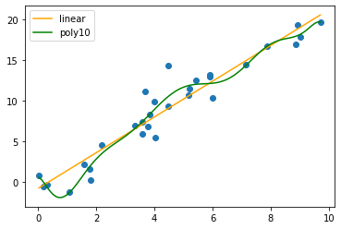

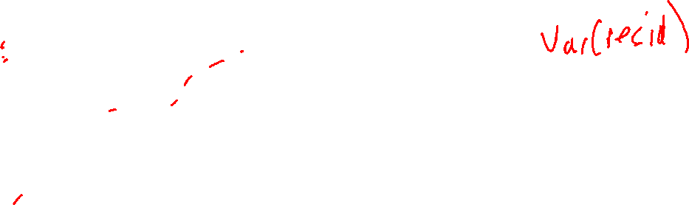
Overfitting
Synthetic linear data
MSE ($\frac{1}{n}{SS}_{resid}$):
Linear: 3.055
Poly10: 2.025

Slide 6
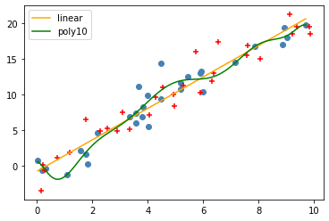
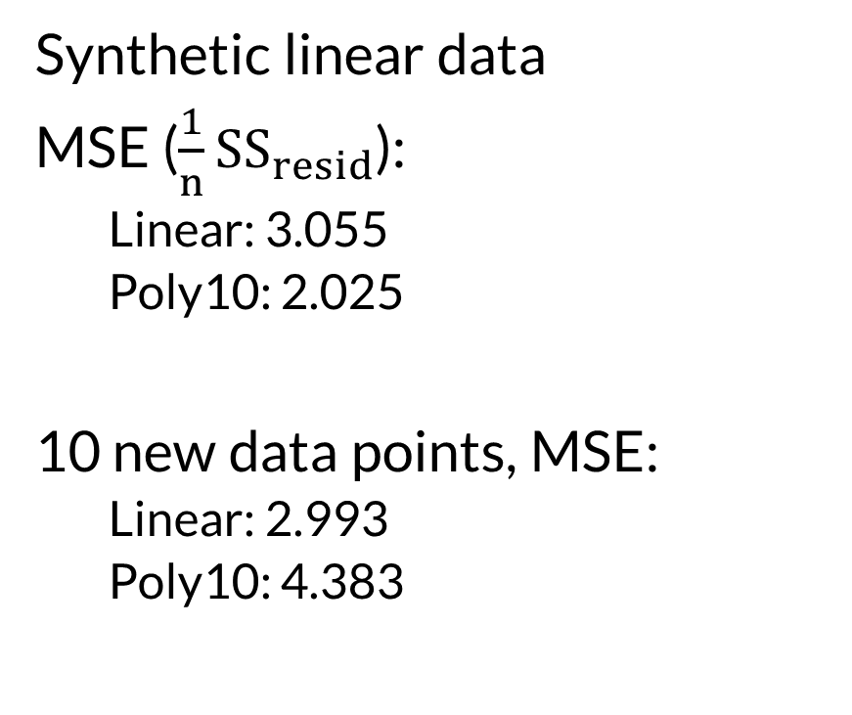
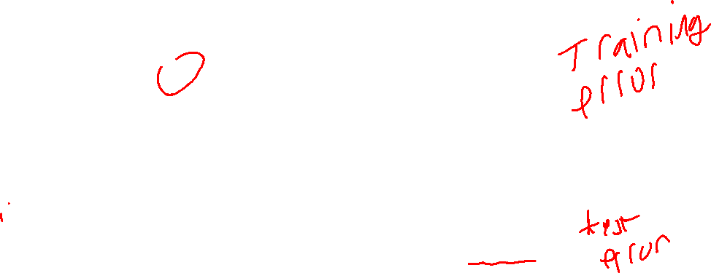
Overfitting
Synthetic linear data
MSE ($\frac{1}{n}{SS}_{resid}$):
Linear: 3.055
Poly10: 2.025
10 new data points, MSE:
Linear: 2.993
Poly10: 4.383

Slide 7

Train-Test
Data
Test data is unseen
Can model generalize to it?
Split
Train
Test
Model
Predict

Slide 8

Fitting to Data
The model structure:
Choice of model (linear, tree, etc.)
Selection & transformation of features
Hyper-parameter values
The model parameters:
Coefficients learned from data
Both can overfit. Train-test addresses parameters.

Slide 9
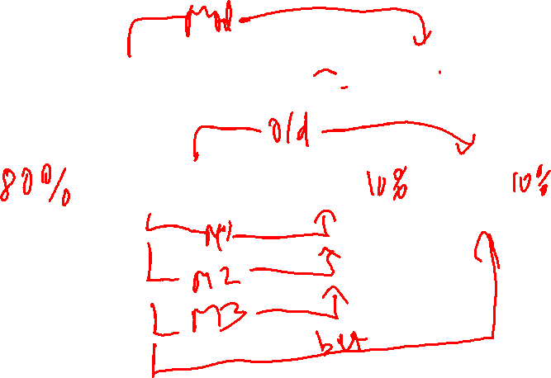
Tuning Data
Data
Train
Test
Train
Tune
Test

Slide 10

Wrapping Up
Overfitting arises when our model learns too much, so it can’t generalize to new data.
Splitting our data into training, tuning, and testing sets helps with this.
Photo by Darren Nunis on Unsplash

